Slide 1
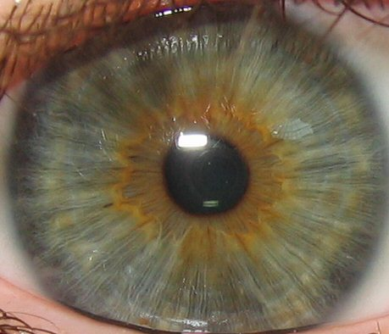
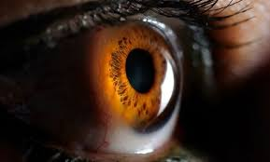
IRIS RECOGNITION SYSTEM
Siddhant Jain
Shubham Gera

Slide 2
Methods of Iris Recognition being used in our project
In identifying one’s iris, there are 2 methods for its recognition and are:
Active
Passive
The active Iris system requires that a user be anywhere from six to fourteen inches away from the camera.
The passive system allows the user to be anywhere from one to three feet away from the camera that locates the focus on the iris.

Slide 3
Iris Recognition Diagram
Iris Segmentation
Image Acquisition
Normalization
Eye Image
Iris Region
Feature points in the iris region
Feature Matching
Feature Encoding
Identify or Reject Subject
Iris Template
Iris Templates Database

Slide 4
WHAT WE HAVE DONE SO FAR ?

Slide 5
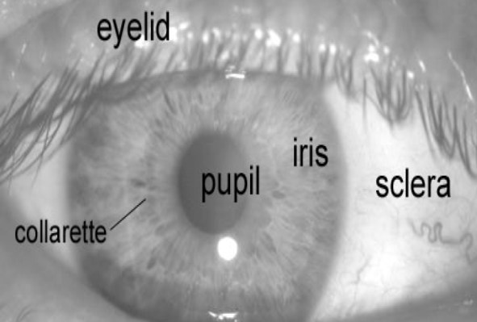
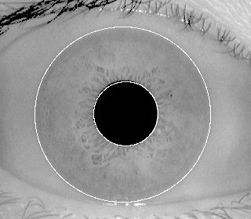
Firstly, an automatic segmentation algorithm is used , which localizes the iris region from an eye image and isolate eyelid, eyelash and reflection areas.
Automatic segmentation is achieved through the use of the circular Hough transform for localizing the iris and pupil regions, and the linear Hough transform for localizing occluding eyelids. Thresholding is also employed for isolating eyelashes and reflections.

Slide 6
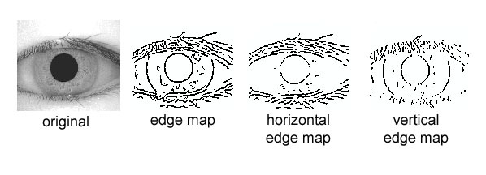
Next, the segmented iris region is normalized to eliminate dimensional inconsistencies between iris regions. This helps in the process of Iris Detection and eliminates any impure / undetected part of the eye or the eyelash from the Database being used .

Slide 7
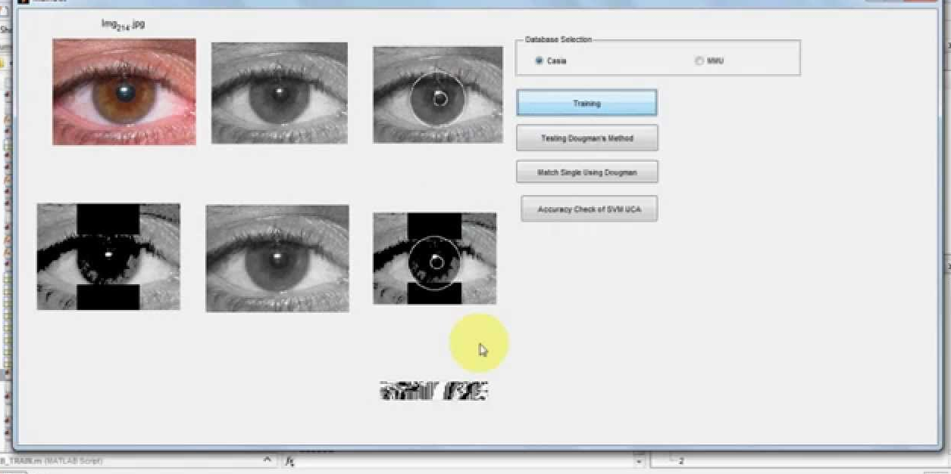

Slide 8
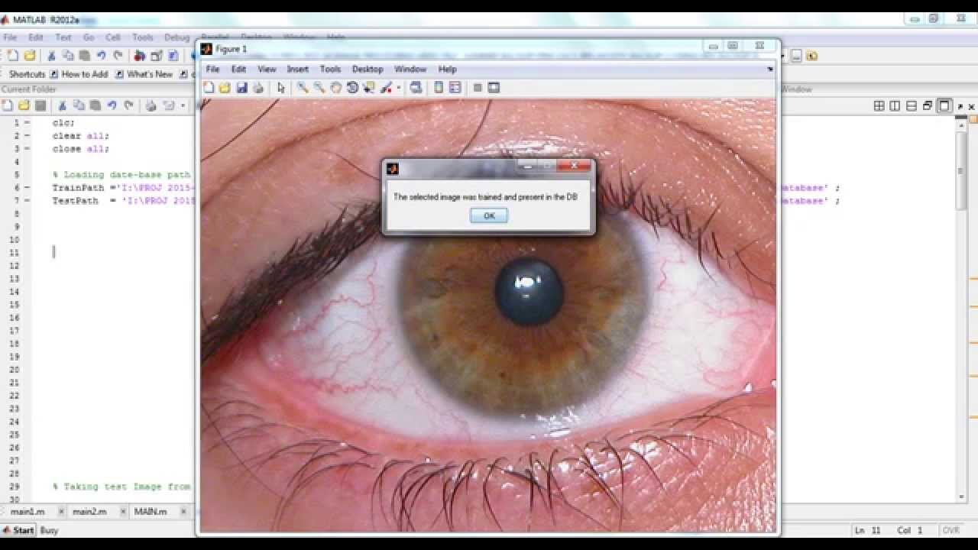

Slide 9
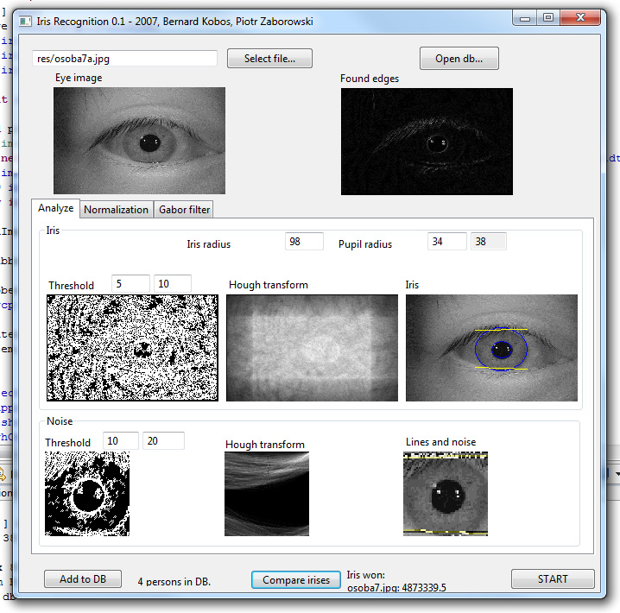

Slide 10
WHATS LEFT TO BE DONE ?

Slide 11
The system presented will be able to perform accurately, however there are still a number of task and issues which need to be addressed.
First of all, the automatic segmentation was not perfect, since it could not successfully segment the iris regions for all of the eye images in the two databases.
An improvement could also be made in the speed of the system. The most computation intensive stages include performing the Hough transform, and calculating Hamming distance values between templates to search for a match.
Also the UI has to be integrated with additional features to be user friendly and perform other various task as well.

Slide 12
THANK YOU

